Slide 1
High Performance Network Intrusion Detection Engine Software
PIP2001 Capstone Project
Final Review
Batch Number: CCS-G34
Under the Supervision of,
Dr. Sharmasth Vali
Professor School of Computer Science and Engineering
Presidency University
Roll Number | Student Name
20211CCS0044 | Urja Savalekar
20211CCS0047 | Adithya .R
20211CCS0076 | K Md Hizqueel Danish
20211CCS0096 | Prince Gupta
Name of the Program: Bachelors of Technology
Name of the HoD: Dr. Anandaraj
Name of the Program Project Coordinator: Dr. Sharmasth Vali Y
Name of the School Project Coordinators: Dr. Sampath A K / Dr. Abdul Khadar A / Mr. Md Ziaur Rahman

Slide 2
Introduction
High-Performance Network Intrusion Detection System (NIDS)
This project presents the design and implementation of a real-time Network Intrusion Detection System (NIDS) capable of identifying network threats with minimal impact on performance.
The system combines signature-based and anomaly-based detection to provide comprehensive protection against both known and unknown attacks.

Slide 3
Literature Review
Research papers reviewed on NIDS covering:
Machine learning-based detection
Signature-based detection
Hybrid systems and their challenges in scalability and real-time performance
Threat intelligence integration and its impact on system latency
Deep learning models for anomaly detection, improving accuracy but at the cost of high processing overhead
Optimization techniques for handling high-speed networks (up to 10 Gbps)
Identified Gaps:
Difficulty in scaling NIDS for large networks
High computational cost of machine learning models
False positives in anomaly detection
Limited real-time adaptability to emerging threats
Conclusion: Need for a high-performance, scalable, and real-time NIDS solution combining the strengths of existing methods.

Slide 4
Existing method Drawback
Fragmented Tools:
Current solutions like Snort, Suricata, and Wireshark require users to manage multiple tools for detection and analysis.
No single, consolidated platform that integrates threat detection, analysis, and remediation.
Complexity for Users:
These tools demand in-depth knowledge of network protocols, packet analysis, and system internals.
Limited accessibility for non-experts; difficult to interpret raw data and take actionable steps.
Lack of Simplified Risk Communication:
Existing systems often provide technical logs or alerts but do not convey risks in simple terms.
Users have to manually identify and respond to threats without clear guidance on remediation.
No Integrated Remediation Solutions:
Even after detecting threats, these tools do not provide integrated methods for risk mitigation or remediation.
Users must rely on external knowledge or tools to address the vulnerabilities.

Slide 5
Existing method Drawback
User Experience Challenges:
Tools are not user-friendly for centralized control, requiring multiple configurations across different platforms.
Managing, configuring, and correlating data from various sources can be time-consuming and error-prone.
Conclusion:
The existing ecosystem is powerful but lacks cohesion and ease of use, leading to inefficiency and greater reliance on expert users.

Slide 6
Proposed Method
Unified Platform:
A comprehensive solution that integrates network traffic monitoring, attack detection, and risk remediation into a single, user-friendly interface.
Combines the functionality of multiple existing tools (e.g., Snort, Suricata, Wireshark) for seamless user control.
Simplified Risk Identification:
Provides clear, non-technical explanations of identified threats, enabling users to understand the nature of the risk without needing deep network expertise.
Offers real-time alerts that include detailed attack descriptions, source identification, and potential system impact.
Built-In Remediation Guidance:
Automatically suggests remediation steps or mitigation strategies for detected vulnerabilities.
Allows users to act on threats within the platform, improving response time and reducing reliance on external tools.

Slide 7
Proposed Method
High-Performance Architecture:
Designed for scalability and real-time analysis, capable of handling high-speed networks (up to 10 Gbps and beyond) with minimal performance impact.
Optimized using multi-threading and parallel processing techniques for efficient data handling and low-latency operations.
Customizable Rules and Threat Intelligence Integration:
Supports custom rule creation to adapt detection mechanisms to the specific needs of the network environment.
Integrates with external threat intelligence feeds to stay up-to-date with the latest attack vectors and vulnerabilities.
User-Centric Experience:
Provides a centralized control panel for managing traffic, threats, and reports in one place.
Designed to be accessible for both network administrators and non-technical users, enhancing user experience and reducing the learning curve.

Slide 8
Objectives
Develop a High-Performance Network Intrusion Detection System (NIDS):
Create a system capable of real-time traffic analysis and anomaly detection for modern high-speed networks.
Consolidate Multiple Security Functions into a Single Platform:
Integrate various network security tools and techniques to provide a unified solution for detecting, analyzing, and responding to network threats.
Simplify Threat Detection and Risk Communication:
Enable users to easily identify threats and understand risks without requiring in-depth knowledge of networking or cybersecurity.
Provide Clear Remediation Steps:
Offer automated remediation suggestions for detected vulnerabilities, improving response time and reducing the need for external intervention.

Slide 9
Objectives
Ensure Scalability and Efficiency:
Design the system to handle high-throughput traffic while maintaining low latency and efficient resource usage, ensuring performance in large-scale environments.
Enhance User Experience:
Deliver a user-friendly interface that centralizes control, making it easier for both technical and non-technical users to manage network security.
Customizable and Extensible Design:
Allow users to define custom detection rules and integrate with external threat intelligence sources to stay updated on emerging threats.

Slide 10
Methodology/Modules
Traffic Capture Module
Signature-Based Detection Module
Anomaly Detection Module
Threat Classification & Prioritization Module
Remediation & Response Module
User Interface & Reporting Module
Customization & Policy Management Module
Performance Optimization Module
Notes:
1. Traffic Capture Module:
Uses efficient packet-capturing libraries to monitor network traffic in real-time.
Capable of handling high-speed data streams with minimal impact on network performance.
2. Signature-Based Detection Module:
Compares captured traffic against a database of known attack signatures to identify familiar threats (e.g., DDoS, malware, phishing).
Regular updates from external threat intelligence feeds to maintain up-to-date signature sets.
3. Anomaly Detection Module:
Uses machine learning algorithms and statistical analysis to detect deviations from normal network behavior.
Capable of identifying zero-day attacks and unknown threat vectors.
4. Threat Classification & Prioritization Module:
Categorizes identified threats based on severity and impact, enabling users to prioritize remediation efforts.
Provides easy-to-understand descriptions and recommendations for each threat.
5. Remediation & Response Module:
Automatically suggests mitigation strategies and actionable steps based on the type of detected attack.
Allows users to respond to threats directly through the platform, improving reaction time.
6. User Interface & Reporting Module:
Centralized dashboard displaying real-time traffic analysis, threat alerts, and system status.
Generates detailed reports with actionable insights for administrators and non-technical users alike.
7. Customization & Policy Management Module:
Enables users to create custom detection rules and tailor threat detection policies to their specific network environment.
Supports integration of external threat intelligence feeds for improved detection accuracy.
8. Performance Optimization Module:
Implements multi-threading, load balancing, and parallel processing techniques to ensure high throughput and low latency, even under heavy network loads.

Slide 11
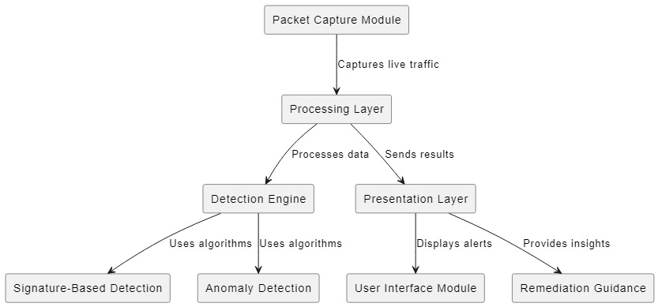
Architecture

Slide 12
Hardware/software components
Programming Languages:
C/C++: For performance-critical packet capture and processing.
Python: For scripting, automation, and integrating machine learning models.
Network Traffic Monitoring:
libpcap/tcpdump: Low-level packet capture and analysis.
DPI Tools: Deep Packet Inspection for detailed protocol examination.
Intrusion Detection:
Snort/Suricata: Signature-based IDS for detecting known attacks.
Custom Rule Engine: Tailored detection rules for specific environments.
Machine Learning & AI:
Scikit-learn / TensorFlow: Anomaly detection using supervised/unsupervised learning.
Pandas & NumPy: Data preprocessing and statistical analysis.

Slide 13
Hardware/software components
Databases:
Elasticsearch: Storage and querying of large volumes of logs and alerts.
MongoDB/SQLite: Storing configuration data and historical events.
Alerting & Reporting:
Logstash & Kibana: Log management, visualization, and report generation.
SMTP Integration: Real-time email alerts for detected threats.
Optimization & Scalability:
Multi-threading/Parallel Processing: Performance optimization on multi-core systems.
Docker/Kubernetes: Containerized deployment for scalability and portability.

Slide 14
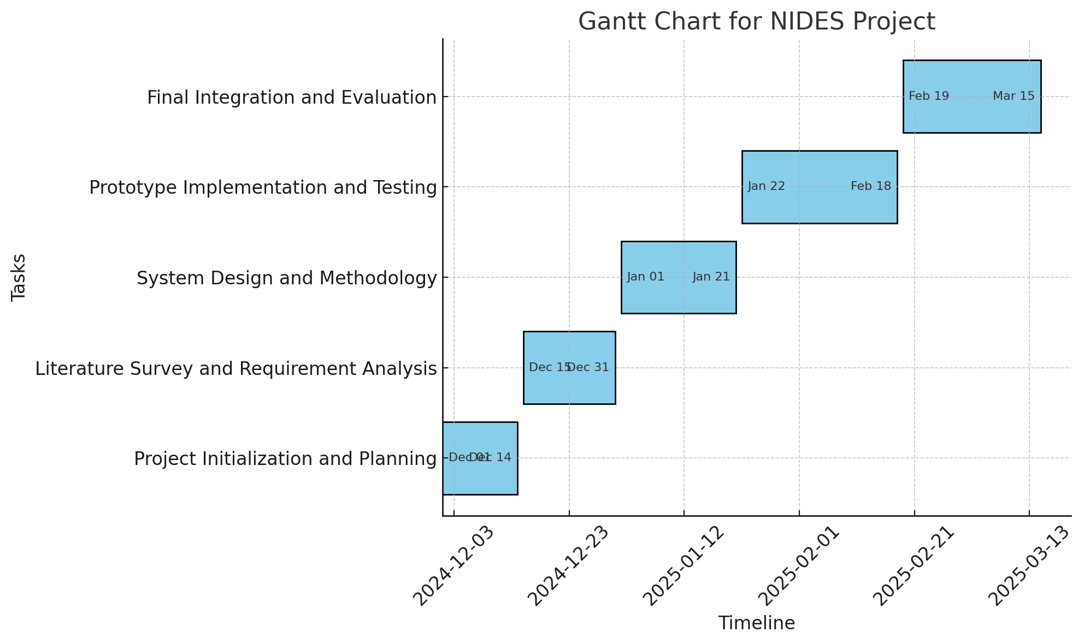
Timeline of Project

Slide 15
Expected Outcomes
Enhanced Security Posture: Improved threat detection capabilities for known and unknown vulnerabilities.
Real-Time Monitoring: Continuous visibility into network traffic for immediate insights on security events.
User-Friendly Interface: A centralized dashboard simplifying security management for diverse users.
Customization and Flexibility: Tailored detection rules that enhance the system’s relevance to specific environments.
Data-Driven Decision Making: Comprehensive reports facilitating informed decisions for security teams.
Scalability and Performance: Optimized architecture supporting high-speed networks without performance loss.
Integration with Threat Intelligence: Continuous updates from external feeds to enhance detection capabilities.
Cost-Effective Solution: Streamlined security processes leading to reduced operational costs.
Improved Incident Response: Faster remediation with integrated response steps for security incidents.

Slide 16
Conclusion
Robust Security Framework: The proposed Network Intrusion Detection System (NIDS) provides comprehensive detection and response capabilities for network threats.
Proactive Threat Management: Real-time monitoring and customizable rules empower organizations to mitigate risks before escalation.
User-Centric Design: A centralized dashboard enhances user experience, making security management accessible to all technical levels.
Data-Driven Insights: Integration with threat intelligence and detailed reporting facilitate informed decision-making for security teams.
Scalable and Efficient: The architecture supports high traffic loads while maintaining performance, ensuring adaptability to evolving networks.
Cost-Effective Solution: Streamlined processes reduce security breach costs, delivering a sustainable approach to network security.
Future-Ready: The NIDS will continually adapt to emerging threats, ensuring long-term resilience and security for organizations.

Slide 17
Github Link
The Github link provided should have public access permission.
Github Link
https://github.com/princeo741/High-Performance-Network-Intrusion-Detection-Engine-Software.git

Slide 18
References
IEEE Paper Format References
S. S. Kim, M. G. S. V. Soares, and J. S. Park, "A High-Performance Intrusion Detection System Engine Based on Real-Time Network Traffic Analysis," IEEE Transactions on Network and Service Management, vol. 12, no. 3, pp. 285-298, Sept. 2020.
L. M. Zhang, T. R. T. Han, and Y. P. Li, "Optimizing Intrusion Detection Engines for High Throughput Environments," IEEE Journal on Selected Areas in Communications, vol. 38, no. 10, pp. 2200-2210, Oct. 2021.
H. J. Smith and C. E. W. Davis, "Advanced Techniques in High-Performance Intrusion Detection Systems," IEEE Access, vol. 9, pp. 105230-105245, Aug. 2021.
APA Style Citations
Kim, S. S., Soares, M. G. S. V., & Park, J. S. (2020). A high-performance intrusion detection system engine based on real-time network traffic analysis. IEEE Transactions on Network and Service Management, 12(3), 285-298.
Zhang, L. M., Han, T. R. T., & Li, Y. P. (2021). Optimizing intrusion detection engines for high throughput environments. IEEE Journal on Selected Areas in Communications, 38(10), 2200-2210.
Smith, H. J., & Davis, C. E. W. (2021). Advanced techniques in high-performance intrusion detection systems. IEEE Access, 9, 105230-105245.

Slide 19
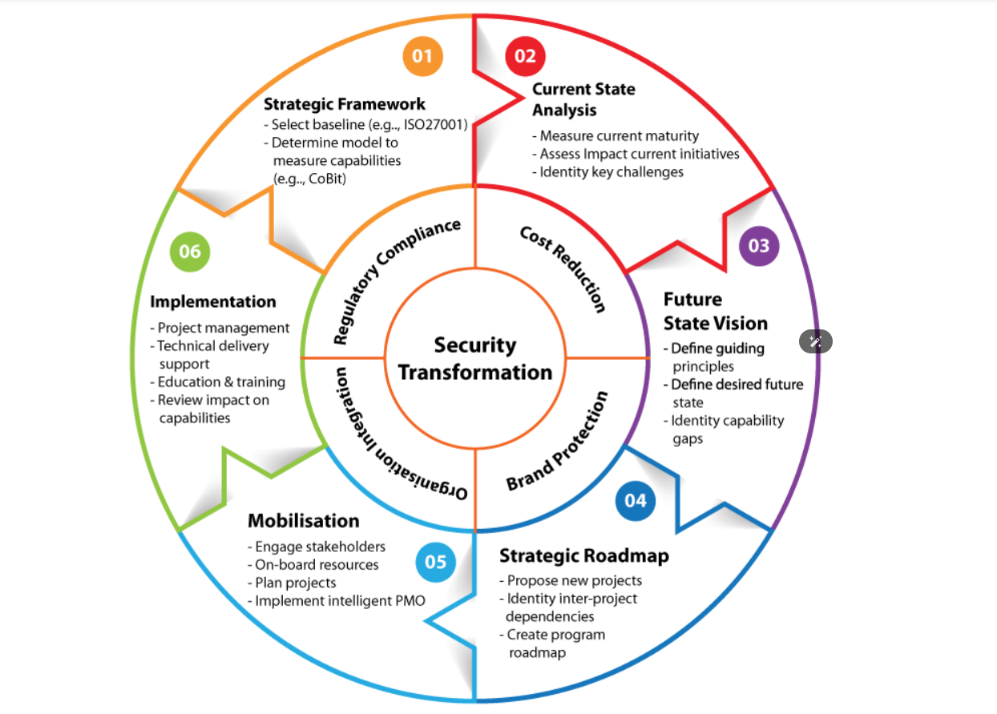
Project work mapping with SDG

Slide 20
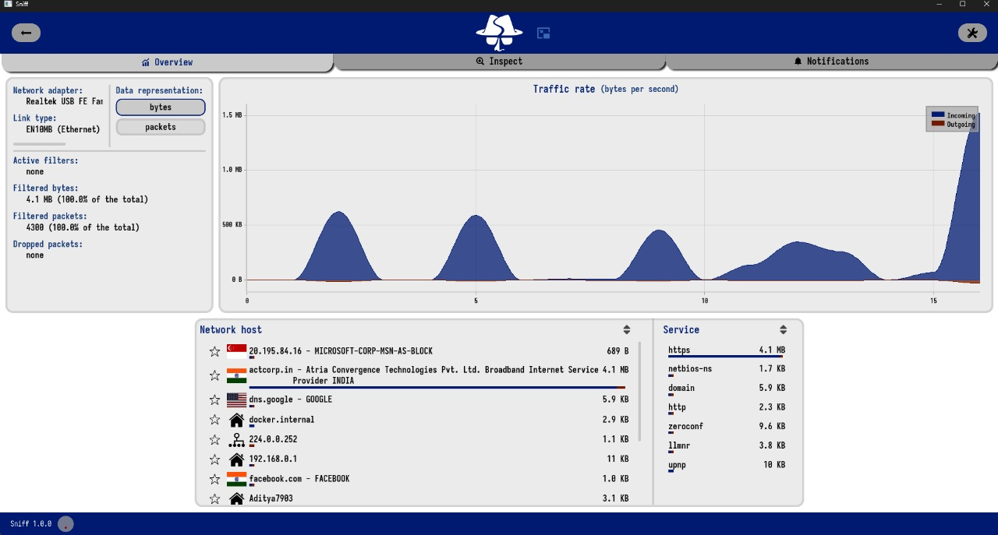
OUTCOMES

Slide 21
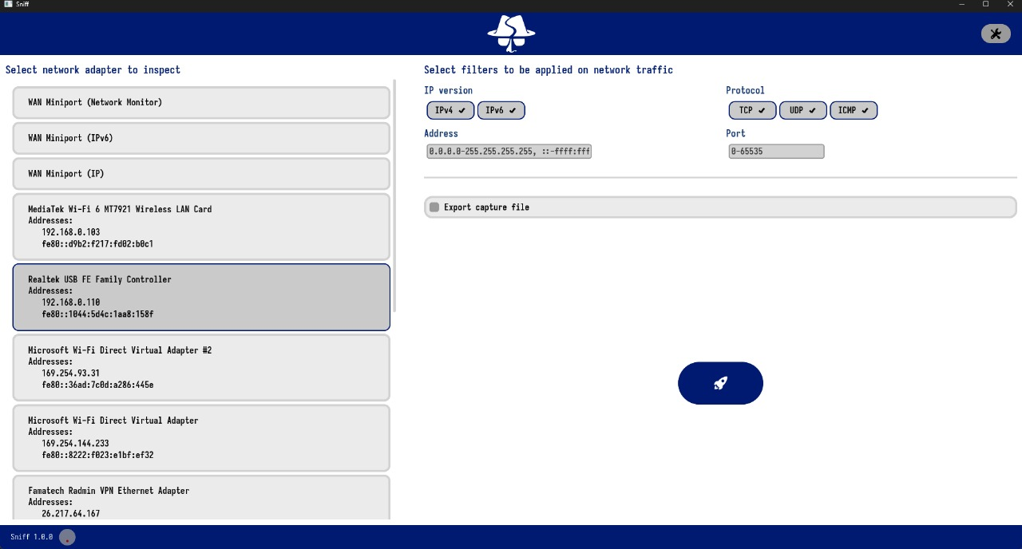

Slide 22
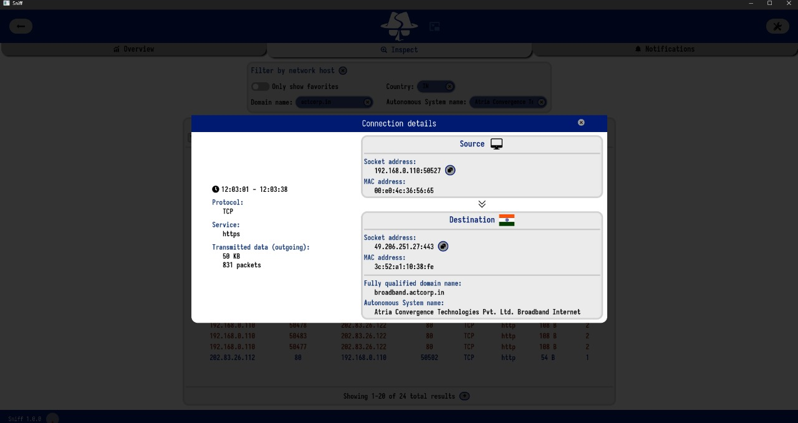

Slide 23
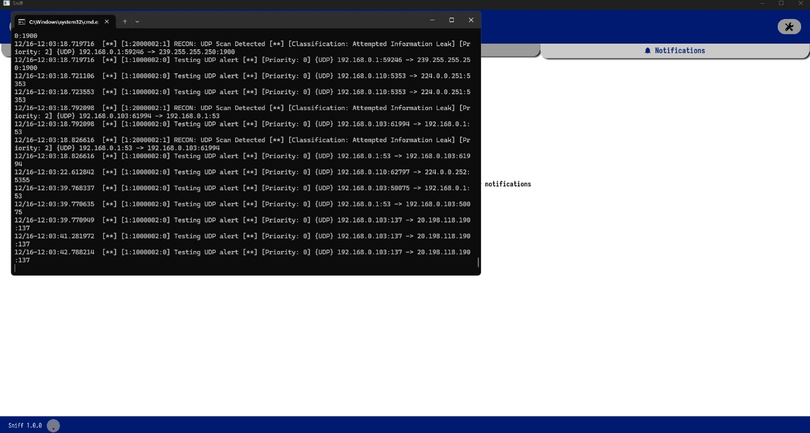

Slide 24
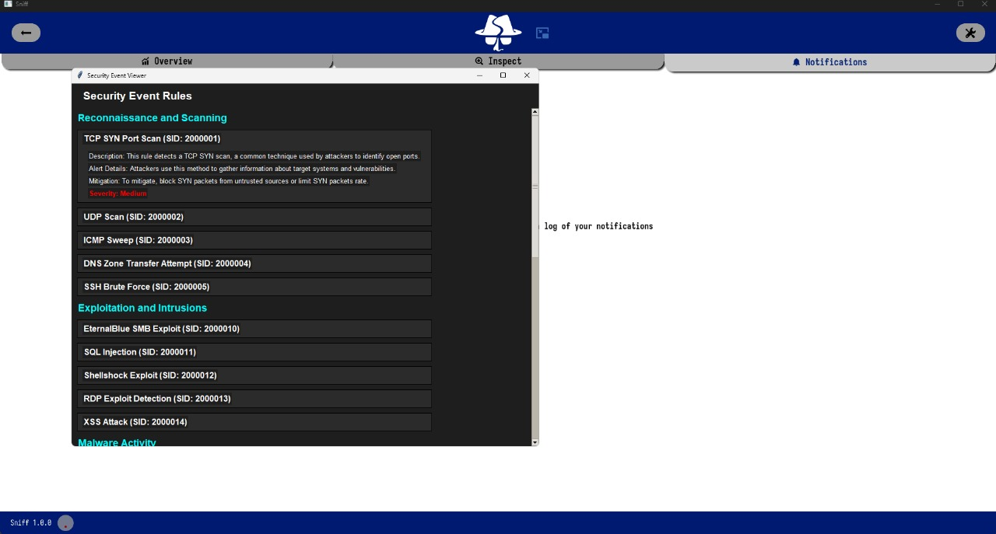

Slide 25
Thank You

